Slide 1
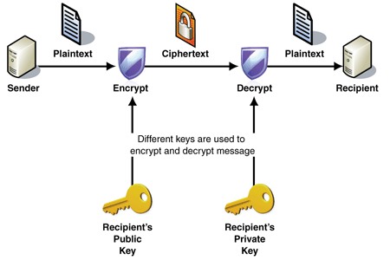
ENCRYPTION AND DECRYPTION USING RSA ALGORITHM:
Group Members:
Ammar Siddiqui (20k-0177)
Muhammad Zunique (20k-0145)
Muaz Zafar (20k-0363)

Slide 2
RSA TECHNIQUE:
In rsa we have different steps to generate encrypt message and decrypt message key.
GENERATING ENCRYPT MESSAGE KEY:
Choose two distinct prime numbers p and q .
2) Then multiply these prime numbers to generate some variable n.
3) Now subtract 1 from both p and q and multiply them and save it in a variable name k then subtract 1 from k to generate some variable e.
The formula of encryption using RSA is:
c=m^{e} mod n
Here e is used as the key , m is message and n is the result of multiplication of p and q.

Slide 3
GENERATING DECRYPT MESSAGE KEY:
THE FORMULA OF DECRYPTION OF A MESSAGE USING RSA IS:
m=c^{d} mod n
Here m is message, c is cipher message n is the result of multiplication of p and q and d is the decryption key.
GENERATING D:
D be the multiplicative inverse of e modulo k .
We calculate multiplicative inverse using bezout algorithm .

Slide 4
BEZOUT ALGORITHM
For understanding bezout algorithm first you have to understand Euclidean algorithm so:
EUCLIDEAN ALGORITHM
The Euclidean Algorithm is an efficient way of computing the GCD of two integers. It was discovered by the Greek mathematician Euclid, who determined that if n goes into x and y, it must go into x-y. Therefore, we can subtract the smaller integer from the larger integer until the remainder is less than the smaller integer. We continue using this process until the remainder is 0, thus leaving us with our GCD.
Now we let discuss bezout algorithm:
For integers a and b, let d be the greatest common divisor, d = GCD (a, b). Then there exists integers x and y such that ax+by=d. Any integer that is of the form ax+by, is a multiple of d.
Use the Euclidean Algorithm to determine the GCD, then work backwards using substitution. WHEN DOING SUBSTITUTION BE VERY CAREFUL OF THE POSITIVES AND NEGATIVES.

Slide 5
REAL LIFE APPLICATION OF RSA
Following are some of the important application of encryption in real world:
Encryption is used in electronic money schemes to protect conventional transaction
In email servers to encrypt and decrypt email to protect them from third party intervention
In cryptography.

Slide 6
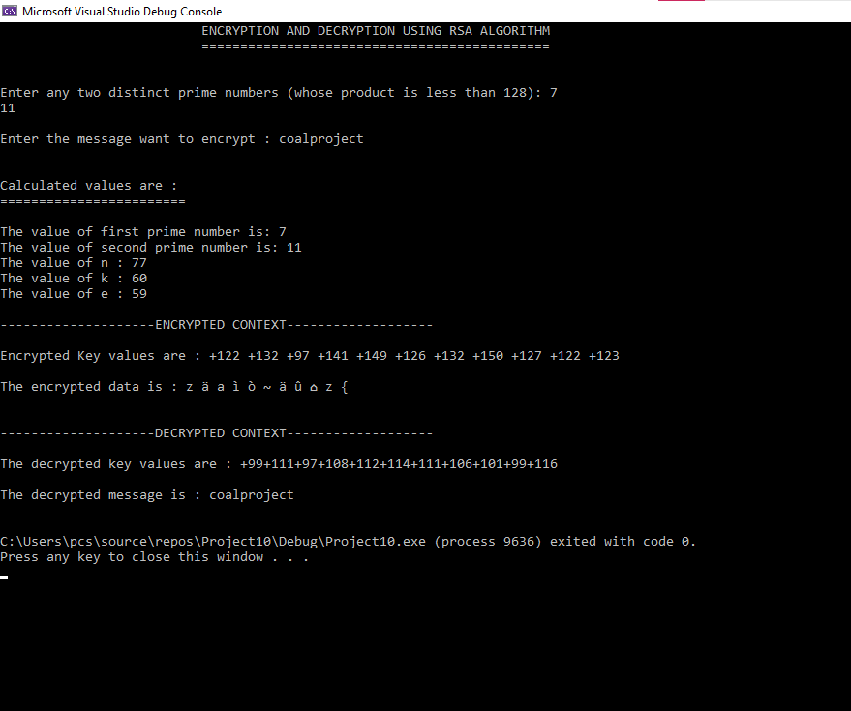
PROJECT OUTPUT SNIP:

Slide 7
THANK YOU

